Slide 1
Project Idea
Lecturer: Ngo Huy Bien
Software Engineering Department
Faculty of Information Technology
VNUHCM - University of Science
Ho Chi Minh City, Vietnam
nhbien@fit.hcmus.edu.vn

Slide 2

Objectives
To identify a project idea.

Slide 3

Contents
Software development jobs
Project types
Project idea
Project proposal

Slide 4

References

Slide 5


Java Developer Hire ($950)
Education: Bachelor of IT/Software Engineering or Information System.
Knowledge of OOP, UML and MVC concept.
Programming languages/ technologies – Java 8, Java EE, EJB, JPA, Hibernate, Spring, JUnit, Mockito, Eclipse RCP, WebServices (RESTful, SOAP), JavaScript, Cordova, JSF, Angular (2), HTML5, CSS3, JQuery, etc.
Knowledge of Database and have done through one of the database management system Oracle, SQL Server, MySQL.
Familiar with quality assurance activities (CMMI)
Develop effective solutions for complex business problems in a variety of customer projects
Integrate new components and technologies into existing software systems.
Conduct system documentation.
Provide system maintenance service.

Slide 6

PHP Developer Hire ($750)
Education: Bachelor of IT/Software Engineering or Information System.
Being expert in PHP, Javascript, HTML, CSS, SQL Databases (preferably MySQL), AJAX.
Having solid competency in all aspects of LAMP stack
Having experience with SVN or GIT
Having worked with at least one PHP framework (e.g.: CakePHP, Laravel, CodeIngiter, Drupal or any MVC framework)
Having worked with at least one Javascript library (eg.: JQuery, Bootstrap, dojo, ...)
Having sound knowledge in web-application security, debugging and tuning web-applications
Having experience in agile software development, i.e. Scrum
Understand and interpret (in writing) project functional requirements.
Outline work task breakdowns for programming side.
Develop web applications.
Coordinate and participate in peer code review

Slide 7

NodeJS Developer Hire ($650)
Degree in Computer Science, Information Technology or equivalent.
Experience with ReactJS, NodeJS, Golang, Docker.
Strong proficiency in JavaScript, including DOM manipulation, the JavaScript object model, specifications of ECMAScript.
Experience with common front-end development tools such as Babel, Webpack, NPM,…
Knowledge of modern authorization mechanisms, such as JSON Web Token.
Understanding of how applications interact with the systems and have experiences with modern software engineering practices and paradigms.
Experience in software development on Linux/Unix, webpage optimization and web browser technology environment would be a plus point.
Working proficiency and communication skills in verbal and written English.

Slide 8

.NET Developer Hire ($750)
Education: Bachelor of IT/Software Engineering or Information System.
Strong knowledge and experience in system design and Web programming with Microsoft .NET and other Microsoft technologies (C#, ASP.NET, XML Web Services, ADO.NET, WCF, Linq, XAML, ASP.NET MVC, Web API, Entity Framework...)
Having experience with database design and programming (MS SQL Server, or Oracle, MySQL,...)
Having worked with SVN, MS Team System, IIS,...
Familiar with software development process.
Good soft skills: team working, problem solving, presentation…
Provide technical & analytic support to customers to identify requirements and develop qualified functionaries/projects.
Outline work task breakdowns for programming side.
Participate in system design and implementation.
Coordinate and participate in code review.

Slide 9

Mobile Developer Hire ($1000)
A University Qualification in Software Engineering or a related degree with at least 02 years experiences in.
Good knowledge in OOP, design pattern, unit testing.
Native Android or iOS: Mobile app development and deployment on Android or iOS platforms.
Java SDK or Android SDK
C/C++, Swift/Objective C, iOS SDK.
React Native Android/iOS: React JS, React Native, Redux, ES6.
Experience in Databases like – Oracle / MySQL, NoSQL Databases (Mongo, etc.)
Honest, energetic and cooperative in team.
Problem solving, punctual.
Work directly, in English, with the founders of new and rapidly growing Internet ventures to understand their vision and implement it on the web and on mobile platforms.
Use eXtreme Programming (XP) and Scrum agile development methods which include paired programming, Behavior Driven Development (BDD), Test Driven Development (TDD), and emergent business-value prioritized development.
Develop applications on Cloud platforms that can grow to support millions of users.

Slide 10

Embedded Developer Hire ($1000)
Bachelor degree or above in related area;
Development skill: Design, Coding, Testing, Debugging;
Embedded C/C++ development;
1 – 4 years of working experience in Automotive related fields;
Have experience in: Linux OS, Cygwin;
Knowledge in automotive communication bus (CAN, LIN, Flex-ray), micro controller;
Knowledge in AUTOSAR;
Familiarity with SW development tools: emulators, debuggers, CANoe/ CANalyzer etc.
Experience in formal software engineering methodology and process (CMMI, A-SPICE)
Able to learn independently and work well under tight development schedules;
Able to explain complex technical information clearly and succinctly;

Slide 11

Machine Learning/AI Developer (Data Scientist) Hire ($750)
A University Qualification in Mathematics or Computer Science or Computer Engineering.
Experience using statistical computer languages (R, Python, SLQ, etc.) to manipulate data and draw insights from large data sets.
At least 2 years’ experience developing projects related to machine learning, chatbot, AI or data mining.
Demonstrated ability in selecting, developing, and applying machine learning and data mining techniques (clustering, decision tree learning, artificial neural networks, etc.).
Experience dealing with large data sets.
Experience in chat bot development or machine learning tools (such as Tensorflow), NLP technologies or AI related projects.
Knowledge of advanced statistical techniques and concepts (regression, properties of distributions, statistical tests and proper usage, etc.)

Slide 12


Slide 13




Your Favorite Project Type
https://bit.ly/3qAAEch

Slide 15


Team Forming
Select 8 team leaders.
Students select a team for themselves. Each team has maximum of 7 members (including a team leader).
If there are surplus students, some teams can have 8 people.
Team leaders send their team members list to class leader.
The class leader collects and puts all the information to a class management file.
The class leader is authorized to assign a team for an individual who is late to class or absent.

Slide 16
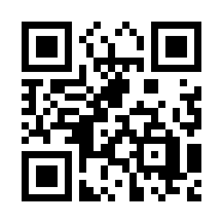


Your Time and Goal
https://bit.ly/3XA46Qm

Slide 18

Project Idea Constraints
Duration: 10 weeks.
Team member: 7 - 9 people.

Slide 19
Project Idea
Mobile applications
Explore apps and games on the App Store and Google Play.
Web applications (which can be combined with mobile apps)
Address real-world business issues and manage big data using technology in sectors such as business, transportation, education, media, healthcare, and banking.
Personal creative ideas.

Slide 20


Idea Walkthrough
Existing product name: …
Existing product URL: …

Slide 21

Group Idea Selection (Voting)

Slide 22

Project Kick-off
Collaboration
Slack. https://slack.com/
Discord. https://discord.com/

Slide 23
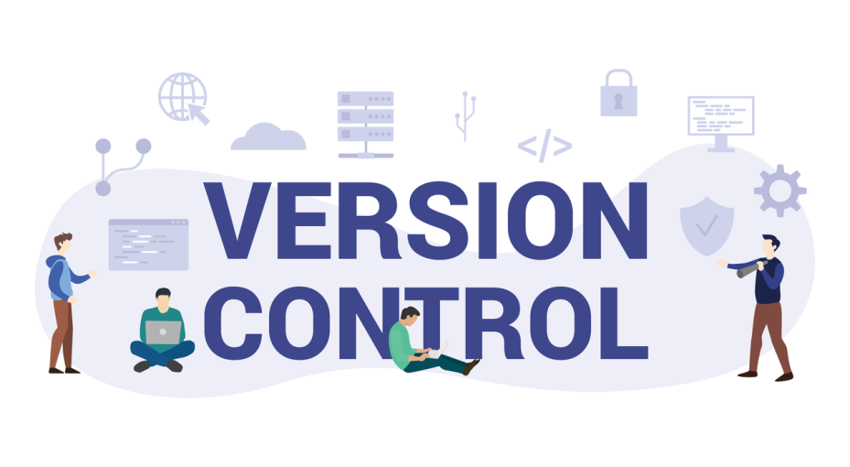
Source Control
GitHub. https://github.com/
GitLab. https://about.gitlab.com/
A repository with README.md

Slide 24

Technical Tools
Python
AWS CLI, Azure CLI, Google Cloud CLI
Visual Studio
Git
Node.js
Postgres, MySQL, MongoDB

Slide 25
Tracking Tools
Trello. https://trello.com/
Atlassian Cloud. https://www.atlassian.com/software/free
Asana. https://asana.com/uses/kanban-boards

Slide 26

Thank You & See You Again

